Slide 1
Italian take away in the heart of Amsterdam
Coursera CAPSTONE PROJECT

Slide 2

Outline
Introduction to the Business Problem
Data acquisition and cleaning
Methodology
Analysis and discussion of Results
Conclusions and future directions
https://99designs.hk/profiles/erennguyen/designs/1123764

Slide 3
Business Problem: background and description
Background
The aim of this project is to find an optimal location for an Italian take away in the heart of Amsterdam. In fact, Italian food is appreciated worldwide and lots of tourists but also locals in their countries use to try Italian specialties even when not in Italy.
The idea of a take away occurred to me while thinking on the way lunch is experienced abroad compared to the Italian lunch, or rather, a rapid break with a sandwich or a slice of pizza instead of a structured lunch with more than one course.
Thus, instead of trying to adapt Italian dishes’ taste to that of the natives, I thought of a way to serve the Italian food in a more “local style”.
Description and interest
This project wants to combine the real needs of the locals and offer products that are made with 100% imported Italian raw materials at the same time. Thus, the whole project is mainly targeted to stakeholders who are interested in or want to bet in the opening of an original venue to provide a new type of food service, that combines the Italian meal authenticity with the local culture.
Lots of tourists and local workers could be interested in having the possibility of eating some fresh and genuine Italian food during their lunch without having to give up to an open-air break.
The most promising neighborhoods will be found based on some criteria that will be explained in the next slide and using the data science instruments. Advantages of each area will be finally expressed so that the best possible location can be chosen by stakeholders.

Slide 4
Data acquisition
Amsterdam is full of Italian restaurants, thus the focus will be first on finding a location with a minor concentration of Italian food venues. Moreover, proximity to city center, universities, offices and green areas will be considered as a parameter to define the best location for the take away.
Based on the problem definition, factors that will influence the choice of the best location are:
number of existing fast food (can be included in the take away category) in the neighborhood
number of and distance to Italian restaurants in the neighborhood (if any)
distance of neighborhood from city center
distance of neighborhood from universities and offices
distance of neighborhood from main parks and green areas
A regularly spaced grid of squared locations, centered around city center, will be used to define the neighborhoods.
To extract and generate the required information, the following data sources will be used:
centers of candidate areas will be generated using algorithms and approximate addresses of the centers of these areas will be obtained using geopy, a Python client for several popular geocoding web services
the number of restaurants, their type and location in each neighborhood will be obtained using Foursquare API
the coordinates of Amsterdam center will be obtained using geopy and the address for the geocoding will be set as that of the well-known Dam Square.

Slide 5
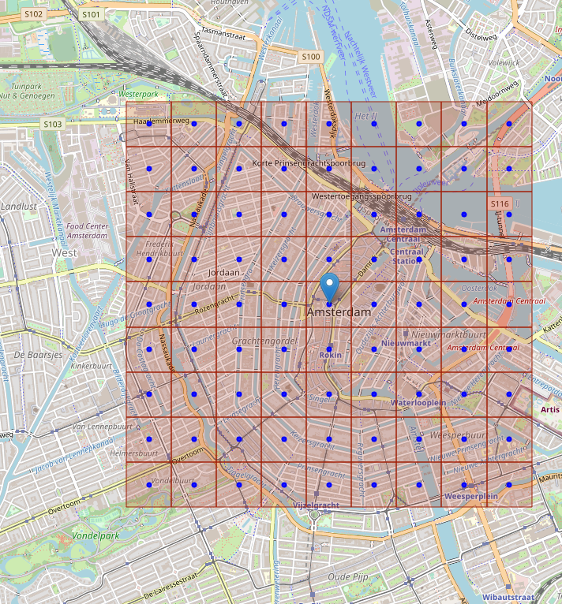

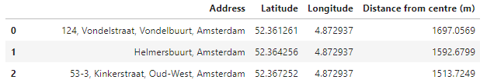
Data cleaning
Latitude and longitude coordinates of all possible neighborhoods have been obtained by creating a grid of cells covering the area of interest (3x3 kilometers centered around Dam Square)
The area of interest is quite small compared to the city limits. Thus, the defined neighborhoods have a squared shape with side of 300 meters and the grid of candidate areas expands till ~1.5km from Dam Square.
The total number of neighborhoods is 81. Given the coordinates of the neighborhoods (area centers), the python geopy geocoder has been used to get approximate addresses of those locations.

Slide 6
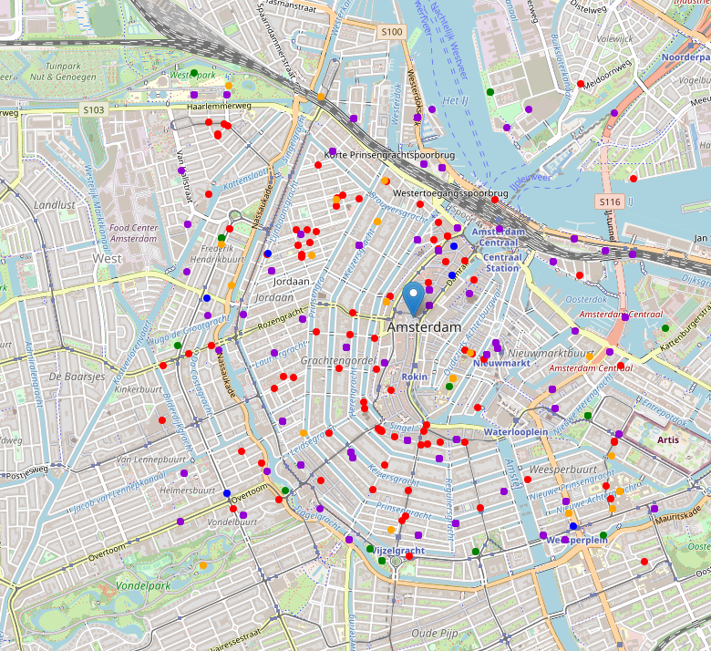
Foursquare API
Foursquare API has been used to get info on food locations, universities, offices and parks in each neighborhood.
The interest is in venues in 'food' category, but only those that are not real restaurants, as the new location will be a take away. However, as it will be an Italian take away, Italian restaurants have been included in the search. In addition, the search comprises parks, universities and offices within the defined neighborhoods.
Map color legend:
red: Italian restaurant
blue: fast food
green: park
orange: university
violet: office

Slide 7
Methodology
Instruments given by exploratory data analysis have been used to inspect the collected data. In particular, efforts have been directed on detecting areas of Amsterdam center that have a low Italian restaurants density and are close to green areas, universities and offices at the same time.
The analysis has been limited to an area of ~3x3km around city center (Dam Square).
In the first step all the required data have been collected (Data acquisition and cleaning).
Second step has been the calculation and investigation of the density and number of restaurants (only Italian), parks, universities and offices across the defined neighbourhoods. Heatmaps have been used to identify a few promising areas close to the centre with low number of Italian restaurants and high density of university, parks and offices. The attention has then been focused on those areas.
In a third and final step, the most promising areas have been analyzed more in detail. From second step results, a small area located south-east from Dam Square and centered in Nieuwmarkt Square has been segmented and clustered to find the best locations for the Italian take away. Indeed this area presents a low density of Italian restaurants coupled with a large number of venues among offices, parks and universities.

Slide 8
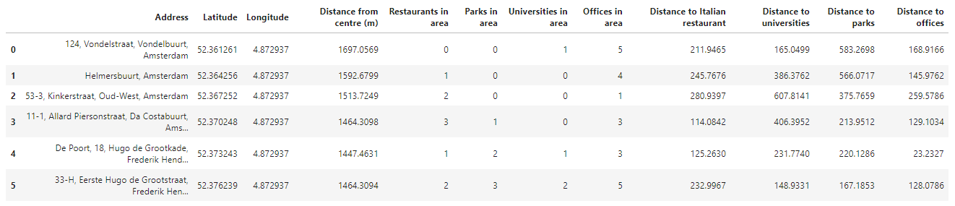
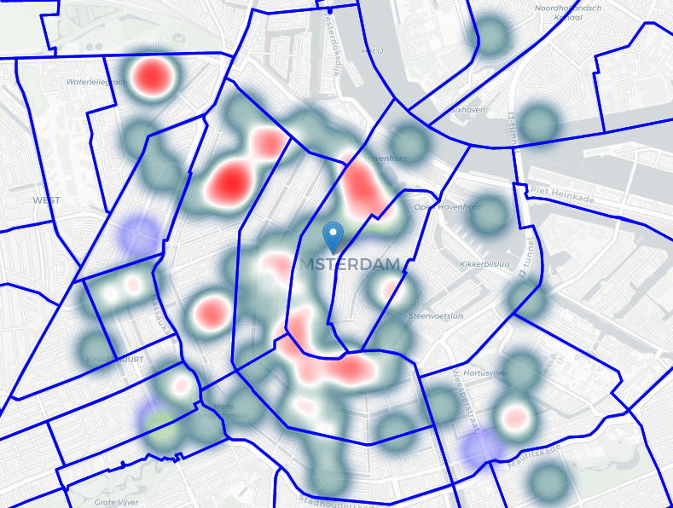
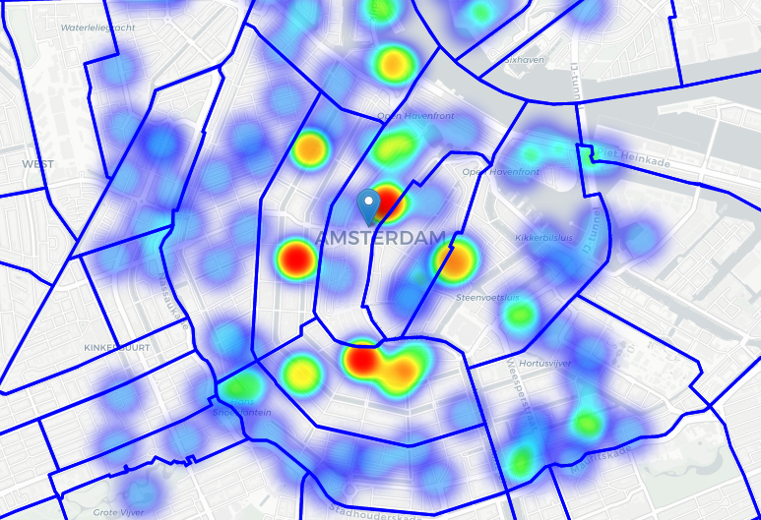
Analysis
Distance from each candidate neighbourhood to the closest venue have been calculated for each venue category.
Number of each venue per candidate area has been also evaluated.
Distances are expressed in metres
Heatmap showing density of parks, universities and offices
Pockets representing good locations for the Italian take away
Heatmap showing Italian restaurants and fast food density

Slide 9
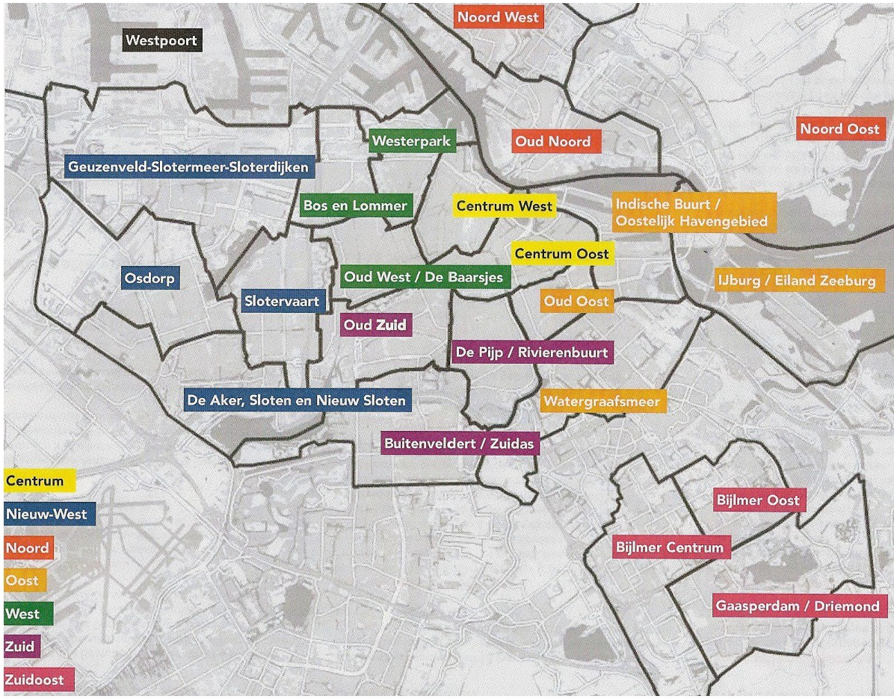
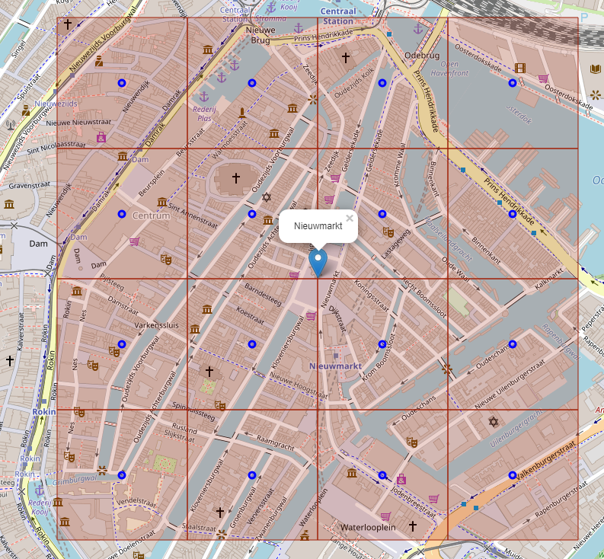

Analysis
Looking at both identified areas, Centrum Oost seems to have a lower Italian restaurants density, especially south-west from Prins-Hendrikkade.
A new and more narrow region of interest, delimited by Prins-Hendrikkade, Dam Square and the Amstel river has then been defined. Almost in the middle of this area there's another quite famous square of Amsterdam, called Nieuwmarkt, whose coordinates has been used to define the center for this new area.
Found areas were filtered to only take into account locations with no more than two restaurants in radius of 200 meters, and at least two venues among Parks, Universities and offices in radius of 200 meters.

Slide 10
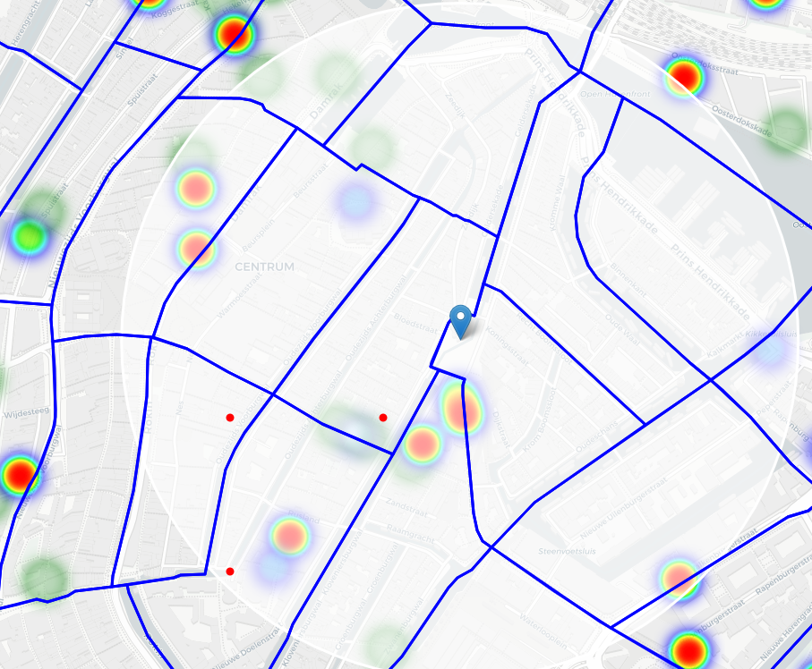
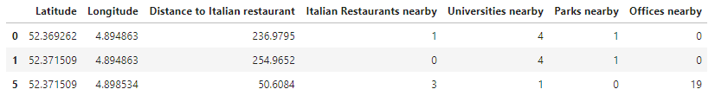
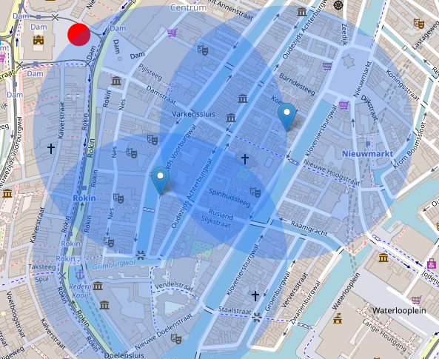
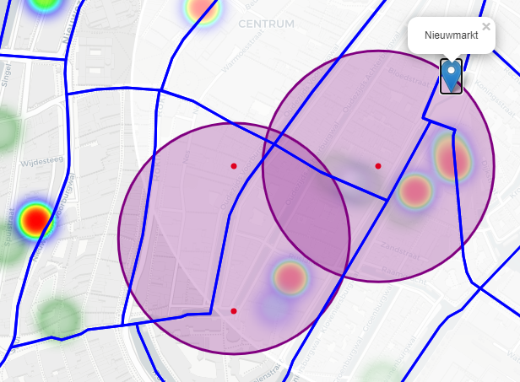
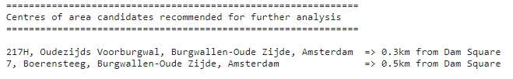
Results
Three possible locations came out from the analysis
These areas have then been clustered to find centers of zones containing good locations.
Final zones, their centers and addresses are the result of the analysis.
The analysis shows that a quite small area located south-east from Dam Square presents a low density of Italian restaurants and a few venues among parks, universities and offices nearby. Hence, given the initial considerations, the found addresses can be considered as good places to open an Italian take away.
K-means clustering
Final addresses of candidate locations for the Italian take away

Slide 11
Conclusions and future directions
Purpose of this project was to identify an area in the heart of Amsterdam with few Italian restaurants in the vicinity but close to offices, universities and parks, in order to help stakeholders in narrowing down the search for optimal locations for an Italian take away. The idea of the project was indeed to provide a new way to taste Italian food, trying to mix the real Italian recipes with a more European way of having lunch.
By calculating Italian restaurants density distribution from Foursquare data, neighborhoods that justify further analysis were first identified. Then, venues in these areas that satisfy the aforementioned prerequisites were collected and clustered to create major zones of interest. Finally, addresses of the centers of these areas were obtained for future usage as a starting point for further exploration by stakeholders.
Final decision on optimal location will be made by stakeholders, based on specific characteristics of neighborhoods and other locations in every recommended zone, considering also additional factors such as zones attractiveness.

